Slide 1

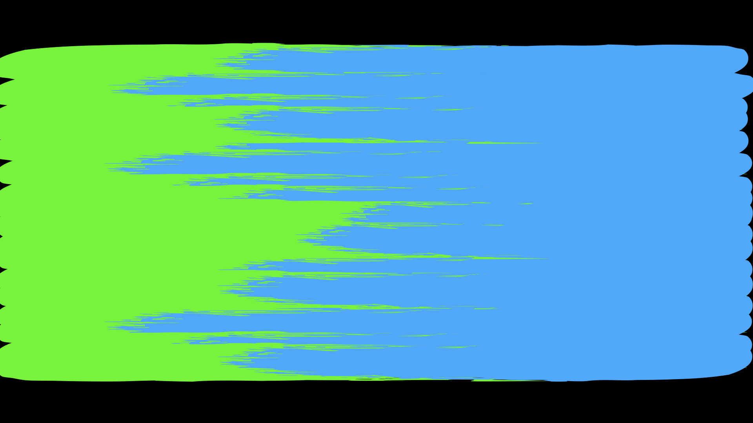
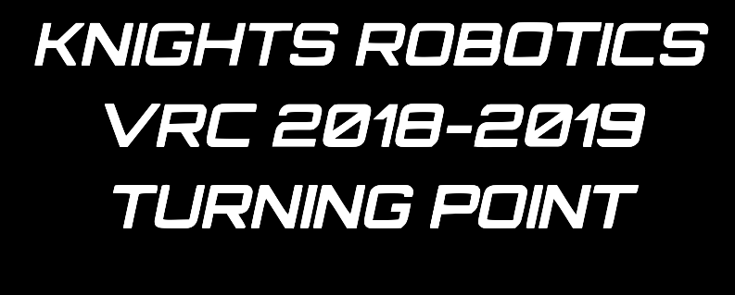

Slide 2
TABLE OF CONTENTS
Introduction
Vision and Mindset
Execution//Progress
Reflection
1

Slide 3
INTRODUCTION
PURPOSE OF THE NOTEBOOK
The software notebook is a valuable tool for recording our thinking, goals, and results in programming for four main uses. The first is so that later on in a project, we can look back to see initial goals, visions, and requirements. It’s a very useful tool because on a project that is worked on for this long, it’s impossible to remember every bit of code one person wrote, and it becomes even more difficult when trying to combine code written by multiple different people like on our team. Secondly, we have found that having to set goals, outline visions, and communicate ideas clearly in writing have all made our work more efficient. It has particularly been helpful with staying on task on getting carried away on tangents that are misdirected. Third, we hope that this document will be a valuable asset to the team in future season. Seeing examples of how different control methods can be implemented and tested by other teams was a valuable resource, and having one written by our own team in increased detail should be useful to our teams in future seasons. Fourth, a notebook is a great way of presenting the engineering process behind the code to other teams and judges.
MEET THE
PROGRAMMERS
JOSHUA SHEW
ELIJAH SHEW
YOSHIKI SAKAI

Slide 4
VISION & MINDSET

Slide 5
PROGRESS LOG

Slide 6
REFLECTION

